Slide 1
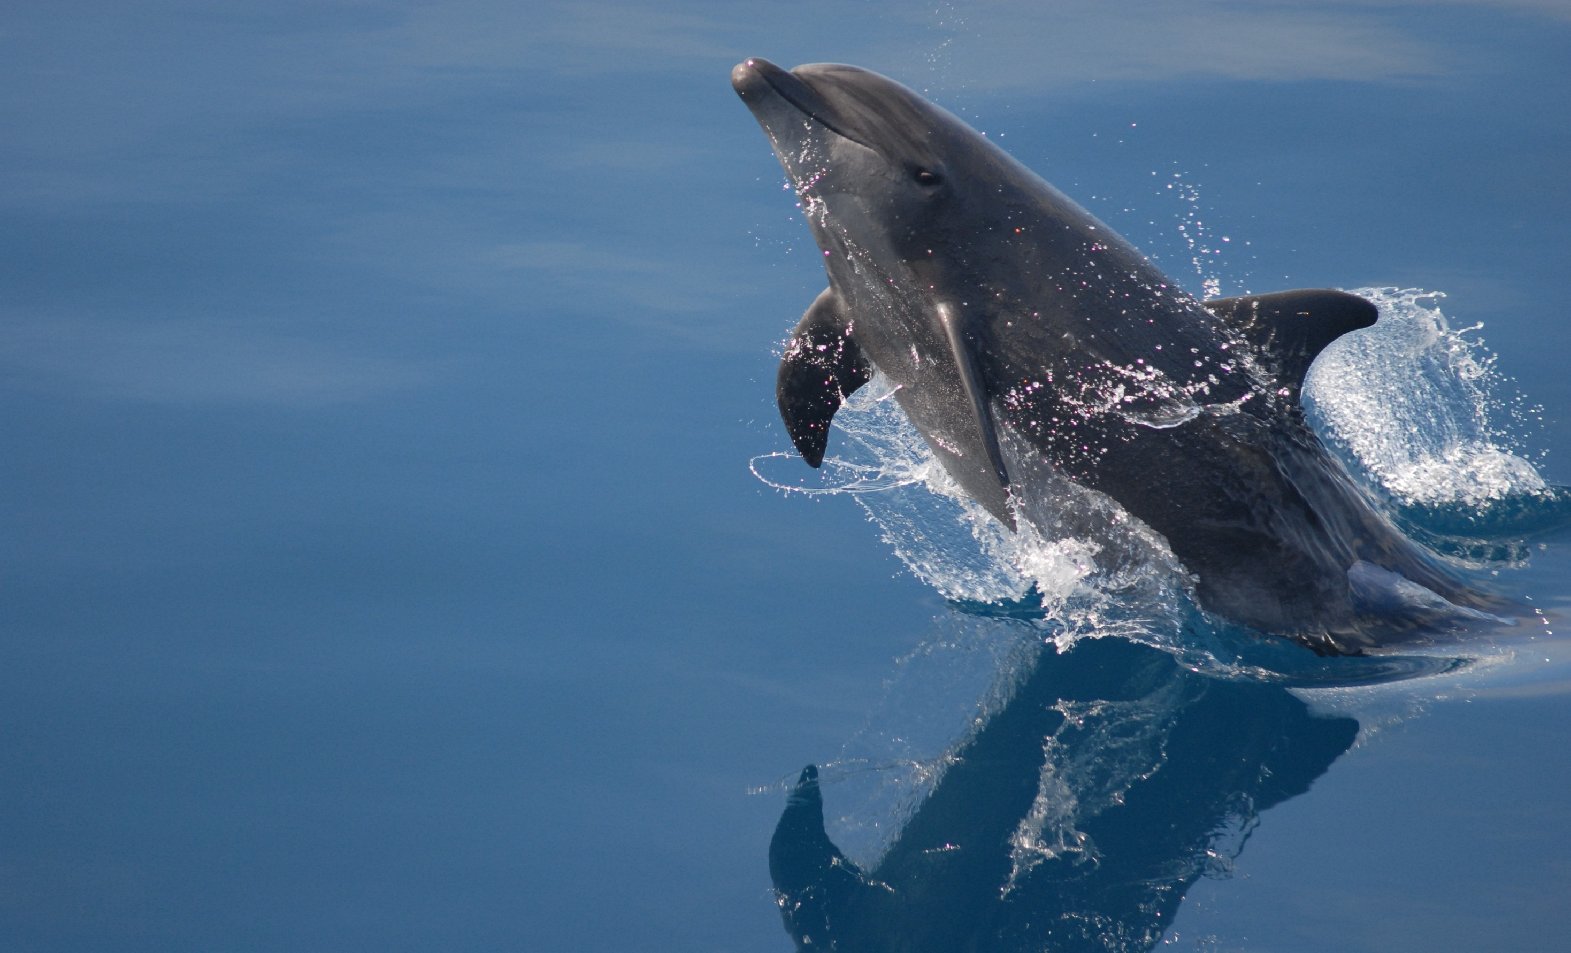



MySQL Performance Schema
A great insight of MySQL server execution​
Mayank Prasad
Principal Member Technical Staff
Oracle, MySQL
March 20, 2016
Copyright © 2014, Oracle and/or its affiliates. All rights reserved. |
Notes:
This is a Title Slide with Picture slide ideal for including a picture with a brief title, subtitle and presenter information.
To customize this slide with your own picture:
Right-click the slide area and choose Format Background from the pop-up menu. From the Fill menu, click Picture and texture fill. Under Insert from: click File. Locate your new picture and click Insert.
To copy the Customized Background from Another Presentation on PC
Click New Slide from the Home tab's Slides group and select Reuse Slides.
Click Browse in the Reuse Slides panel and select Browse Files. Double-click the PowerPoint presentation that contains the background you wish to copy.
Check Keep Source Formatting and click the slide that contains the background you want.
Click the left-hand slide preview to which you wish to apply the new master layout.
Apply New Layout (Important): Right-click any selected slide, point to Layout, and click the slide containing the desired layout from the layout gallery.
Delete any unwanted slides or duplicates.
To copy the Customized Background from Another Presentation on Mac
Click New Slide from the Home tab's Slides group and select Insert Slides from Other Presentation…
Navigate to the PowerPoint presentation file that contains the background you wish to copy. Double-click or press Insert. This prompts the Slide Finder dialogue box.
Make sure Keep design of original slides is unchecked and click the slide(s) that contains the background you want. Hold Shift key to select multiple slides.
Click the left-hand slide preview to which you wish to apply the new master layout.
Apply New Layout (Important): Click Layout from the Home tab's Slides group, and click the slide containing the desired layout from the layout gallery.
Delete any unwanted slides or duplicates.

Slide 2
Notes:
This is a Safe Harbor Front slide, one of two Safe Harbor Statement slides included in this template.
One of the Safe Harbor slides must be used if your presentation covers material affected by Oracle’s Revenue Recognition Policy
To learn more about this policy, e-mail: Revrec-americasiebc_us@oracle.com
For internal communication, Safe Harbor Statements are not required. However, there is an applicable disclaimer (Exhibit E) that should be used, found in the Oracle Revenue Recognition Policy for Future Product Communications. Copy and paste this link into a web browser, to find out more information.
http://my.oracle.com/site/fin/gfo/GlobalProcesses/cnt452504.pdf
For all external communications such as press release, roadmaps, PowerPoint presentations, Safe Harbor Statements are required. You can refer to the link mentioned above to find out additional information/disclaimers required depending on your audience.

Slide 3
Program Agenda
1
Need and Design
Instruments and instrumentation
Statistics tables
Use cases
What’s new in MySQL 5.7
2
3
4
5

Slide 4
Program Agenda
1
Need and Design
Instruments and instrumentation
Statistics tables
Use cases
What’s new in MySQL 5.7
2
3
4
5

Slide 5







Why Performance Schema?
Hot table?
Too much disk spin?
Slow application?
Code contention?
Application Developer
DBA
High traffic on link?
Storage
?
MySQL Developer
Network
Low throughput?
Session stuck?
End User
System

Slide 6

What it is?
“Performance Schema is a mechanism to give user
an insight of what is happening behind the scene
when MySQL server is running.”
Introduced in MySQL 5.5
New storage engine : Performance Schema
New Database : performance_schema
Statistics stored in tables (hard coded DDLs).
Non persistent data
SQL user interface

Slide 7

MySQL 5.7 Performance Schema : Design
Block Diagram
Statistics Collection
Statistics Reporting
Instrumentation points (P_S hooks)
SQL Query
MySQL
Server
Storage Engine Interface
P_S Storage Engine
Statistics Report
P_S Tables
Collect Data
Store Data
Fetch Data
P_S Internal Buffers

Slide 8
Program Agenda
1
Need and Design
Instruments and instrumentation
Statistics tables
Use cases
What’s new in MySQL 5.7
2
3
4
5

Slide 9
Instruments
Name of monitored activity.
Tree like structure. Separated by ‘/’.
Left to right : More generic to more specific.
1000+ instruments in MySQL 5.7.
Stored in performance_schema.setup_instruments table.
wait/io/file/myisam/log
statement/sql/select

Slide 10
Instruments contd…
Configurable at runtime.
Table setup_instruments
SETUP_INSTRUMENTS
NAME | ENABLED | TIMED
statement/sql/select | YES | YES
statement/sql/create_table | YES | NO
statement/com/Create DB | NO | NO
… |  | …
stage/sql/closing tables | NO | NO
stage/sql/Opening tables | NO | NO
stage/sql/optimizing | YES | YES

Slide 11
Program Agenda
1
Need and Design
Instruments and instrumentation
Statistics tables
Use cases
What’s new in MySQL 5.7
2
3
4
5

Slide 12
Statistics Tables in Performance Schema
SETUP TABLES
Instruments
Actors
Objects
Consumers
TIMERS
EVENTS TABLES
Transactions
Statements
Stages
Waits
Idle
SUMMARY TABLES
Events
Memory
File I/O, Table I/O, Table locks
Socket
Connection
…
INSTANCE TABLES
Mutex
RW_locks
File
Sockets
Cond
LOCK TABLES
Metadata locks
Table Handles
REPLICATION SUMMARY
SYSTEM VARIABLES
STATUS VARIABLES
CONNECTION
Attribute
Type
MISC
By_global
By_thread
By_user/host
By_account
By_digest

Slide 13
Program Agenda
1
Need and Design
Instruments and instrumentation
Statistics tables
Use cases
What’s new in MySQL 5.7
2
3
4
5

Slide 14
What does Performance Schema provide …
update performance_schema.setup_instruments set ENABLED='YES', TIMED='YES';
Connection 1 (Thread 24)
start transaction;
insert into test.t1 values('11');
commit;
start transaction;
insert into test.t1 values('12'); commit;
start transaction;
insert into test.t1 values('13'); commit;
select * from test.t1;
Connection 2 (Thread 25)
start transaction;
insert into test.t2 values('21'); commit;
start transaction;
insert into test.t2 values('22'); commit;
Two inserts
Three inserts
Latest Statement

Slide 15
What does Performance Schema provide … (cont.)
Statements Statistics
EVENTS_STATEMENTS_CURRENT
THREAD_ID | 24 | 25
EVENT_NAME | statement/sql/select | statement/sql/commit
TIMER_WAIT | 876585000 | 15998287000
SQL_TEXT | select * from test.t1 | commit
ROWS_SENT | 3 | 0
NO_INDEX_USED | 0 | 0
SELECT_SCAN | 1 | 0
EVENTS_STATEMENTS_SUMMARY_BY_THREAD_BY_EVENT_NAME
THREAD_ID | 24 | 25
EVENT_NAME | statement/sql/insert | statement/sql/insert
COUNT_STAR | 3 | 2
SUM_TIMER_WAIT | 35181659000 | 3477432000
SUM_ROWS_AFFECTED | 3 | 2
SUM_SELECT_SCAN | 0 | 0
SUM_NO_INDEX_USED | 0 | 0
* Timer unit is PICOSECOND.

Slide 16
What does Performance Schema provide … (cont.)
Statements Statistics (cont.)
EVENTS_STATEMENTS_SUMMARY_GLOBAL_BY_EVENT_NAME
EVENT_NAME | statement/sql/insert | statement/sql/commit
COUNT_STAR | 5 | 5
SUM_TIMER_WAIT | 38659091000 | 65812216000
… | …
SUM_ROWS_AFFECTED | 5 | 0
… | … | …
* Timer unit is PICOSECOND.

Slide 17
Use case 1
Problem statement
Multiple queries running for long on MySQL Server
Few long running query (taking lots of time)
No idea which one
No idea why
What to do ? …

Slide 18
Use case 1
Diagnosis
THREAD_ID: 25
EVENT_ID: 89
EVENT_NAME: statement/sql/select
SQL_TEXT : select bla bla bla…;
Wait ! There’s more!
SELECT_SCAN : 1
NO_INDEX_USED: 1
Aha !!
SELECT * FROM events_statements_history WHERE TIMER_WAIT > ‘X’;

Slide 19
Use case 2
Statements giving errors ( or warnings)
SELECT DIGEST_TEXT, SCHEMA_NAME, COUNT_STAR, SUM_ERRORS, SUM_WARNINGS FROM performance_schema.events_statements_summary_by_digest WHERE SUM_ERRORS > 0 ORDER BY SUM_ERRORS DESC limit 1\G;
EVENTS_STATEMENTS_SUMMARY_BY_DIGEST
DIGEST_TEXT | CREATE TEMPORARY TABLE IF NOT ... _logs` ( `id` INT8 NOT NULL )!
SCHEMA_NAME | mem
COUNT_STAR | 1725
SUM_ERRORS | 1725
SUM_WARNINGS | 0
FIRST_SEEN | 2014-05-20 10:42:32
LAST_SEEN | 2014-05-21 18:39:22

Slide 20
Use case 3
Problem Statement
Multithreaded environment
My session is stuck
No idea why
What to do ? …

Slide 21
Use case 3
Diagnosis
What T1 is waiting for
Say T1 is waiting for mutex_A (column OBJECT_INSTANCE_BEGIN)
Lets see who has taken this mutex_A
Ok, so thread T2 is holding mutex_A (column LOCKED_BY_THREAD_ID)
Find out what thread t2 is waiting for
And so on…
SELECT * FROM events_waits_current WHERE THREAD_ID = T1;
SELECT * FROM mutex_instances WHERE OBJECT_INSTANCE_BEGIN = mutex_A;
SELECT * FROM events_waits_current WHERE THREAD_ID = T2;

Slide 22
Event Hierarchy
Session
Transaction
*Statement
Stage
Wait
sync, lock, i/o
* Statements for non-transactions tables are not part of Transaction instrumentation.

Slide 23
Event Hierarchy
Transactions
Statements
Stages
Waits
event_id
nesting_event_id
event_id
nesting_event_id
event_id
nesting_event_id
event_id
nesting_event_id
event_id
nesting_event_id
event_id
nesting_event_id
event_id
nesting_event_id
event_id
nesting_event_id

Slide 24
Instruments available
Monitored activities
Instrumentation for
I/O operation (file, table, NET)
Locking (mutex, r/w locks, table locks, MDLs)
EVENT (transactions, statements, stages, waits, idle)
Stored Programs (Procedures, Functions, Triggers, Events)
User/host/account
Memory
And many more …

Slide 25
Program Agenda
1
Need and Design
Instruments and instrumentation
Statistics tables
Use cases
What’s new in MySQL 5.7
2
3
4
5

Slide 26

What’s new in MySQL 5.7
87 Tables and 1000+ Instruments
Memory usage
transactions
Configurable digest size
History per session
Stored programs
User variables
Prepared statements
New
Instruments
Enhancements
MySQL 5.7
Metadata locks
Global/Session variables/status
Scalable memory allocation
…
Connection type
InnoDB Stages
Replication summary tables
Reduced memory foot print
26
26

Slide 27
What’s new in MySQL 5.7
SYS Schema (earlier known as P_S Helper)
Formatted Statistics
Many of common day to day use cases for DBAs debugging
And tuning
SYS SCHEMA
Procedures
Functions
Views
Performance Schema tables
Information Schema tables

Slide 28
Thank You! Q&A ?
Copyright © 2014, Oracle and/or its affiliates. All rights reserved. |
Notes:
This is a Title Slide with Picture slide ideal for including a picture with a brief title, subtitle and presenter information.
To customize this slide with your own picture:
Right-click the slide area and choose Format Background from the pop-up menu. From the Fill menu, click Picture and texture fill. Under Insert from: click File. Locate your new picture and click Insert.
To copy the Customized Background from Another Presentation on PC
Click New Slide from the Home tab's Slides group and select Reuse Slides.
Click Browse in the Reuse Slides panel and select Browse Files. Double-click the PowerPoint presentation that contains the background you wish to copy.
Check Keep Source Formatting and click the slide that contains the background you want.
Click the left-hand slide preview to which you wish to apply the new master layout.
Apply New Layout (Important): Right-click any selected slide, point to Layout, and click the slide containing the desired layout from the layout gallery.
Delete any unwanted slides or duplicates.
To copy the Customized Background from Another Presentation on Mac
Click New Slide from the Home tab's Slides group and select Insert Slides from Other Presentation…
Navigate to the PowerPoint presentation file that contains the background you wish to copy. Double-click or press Insert. This prompts the Slide Finder dialogue box.
Make sure Keep design of original slides is unchecked and click the slide(s) that contains the background you want. Hold Shift key to select multiple slides.
Click the left-hand slide preview to which you wish to apply the new master layout.
Apply New Layout (Important): Click Layout from the Home tab's Slides group, and click the slide containing the desired layout from the layout gallery.
Delete any unwanted slides or duplicates.

